Slide 1
Dyslexia & Related Disorders Parent Night
10/18/2023
Karena Hayes, M.Ed & Julie Joesel, LSSP

Slide 2
Welcome & Introductions
Karena Hayes, M.Ed.
Master's degree from Texas State University in Special Education
Certified Teacher in EC-6, SPED K-12, ESL
Lead Dyslexia Interventionist- MTA Training
CALT in training
Julie Joesel, M.A., LSSP
Master's degree from Texas State University in School Psychology
Current Lead School Psychologist for the district

Slide 3
Overview & Objectives
Gain an understanding of
Dyslexia (Definition, Signs, Risk Factors)
Dysgraphia (Definition, Characteristics)
Evaluation Process
Dyslexia Intervention
Parent Resources

Slide 4
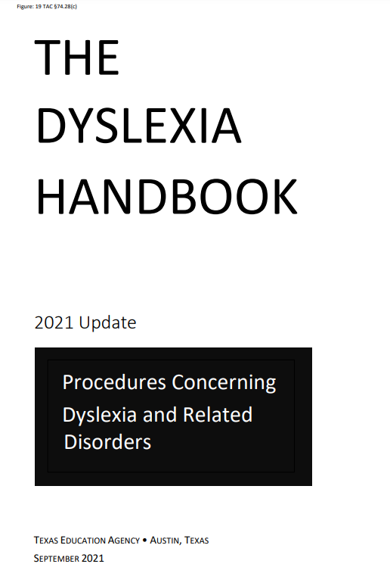
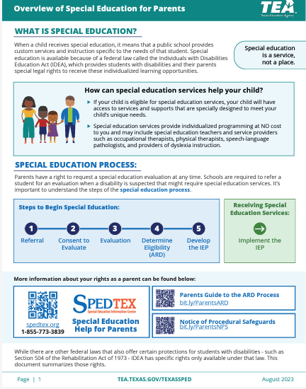
https://tea.texas.gov/academics/special-student-populations/dyslexia-and-related-disorders

Slide 5
Dyslexia- What is it?
Dyslexia is a specific learning disability that is neurobiological in origin.
It is characterized by difficulties with accurate and/or fluent word recognition and by poor spelling and decoding abilities.
These difficulties typically result from a deficit in the phonological component of language that is often unexpected in relation to other cognitive abilities and the provision of effective classroom instruction.
Secondary consequences may include problems in reading comprehension and reduced reading experience that can impeded growth of vocabulary and background knowledge.
International Dyslexia Association​

Slide 6
Primary Characteristics
Difficulty with:
reading words in isolation
decoding unfamiliar words
***Individuals demonstrate difference in degree of impairment and may not exhibit all the characteristics listed above***​
​
(2021 Dyslexia Handbook pg 1)
spelling
oral reading (slow, inaccurate or labored without prosody)

Slide 7
Primary Characteristics
The reading/spelling characteristics are most often associated with the following:
• Segmenting, blending, and manipulating sounds in words (phonemic awareness)
• Learning the names of letters and their associated sounds
• Holding information about sounds and words in memory (phonological memory)
• Rapidly recalling the names of familiar objects, colors, or letters of the alphabet (rapid naming)
Consequences of dyslexia may include the following:
• Variable difficulty with aspects of reading comprehension
• Variable difficulty with aspects of written language
• Limited vocabulary growth due to reduced reading experiences
C-A-T
ABC

Slide 8
Dyslexia Basics
Genetic Component
Genetic element, often a family member link
Across Demographics
Early Intervention
It is found across different languages, genders, socioeconomic status
Intervention takes 4x as long in 4th grade vs. late kinder. (IDA 2022)
Not New
Neurodevelopmental
First documented cases in 17th century
Wagner et.al 2020
Ongoing research on the brain & reading

Slide 9
Risk Factors by Grade
2-3
Written expression
6-12
K-1
Post-Secondary
Difficulty With:
Spelling
Syllables
Rhyming
Names of letters
Orders of alphabet
Remember sounds
Decoding
Difficulty with:
Decoding
Letter patterns
Reading fluently
Sight words
4-5
Difficulty with:
Reading aloud
Avoidance
Reading fluently
Less vocabulary
Decoding
Simple words for writing
Difficulty with:
Volume of reading & writing
Frustration with time & energy for reading
Decoding
Written assignments
Reading fluency
Foreign languages
Difficulty with:
Pronouncing names, remembering names
Word retrieval
Notetaking
Remembering sequences (math/science formulas)

Slide 10
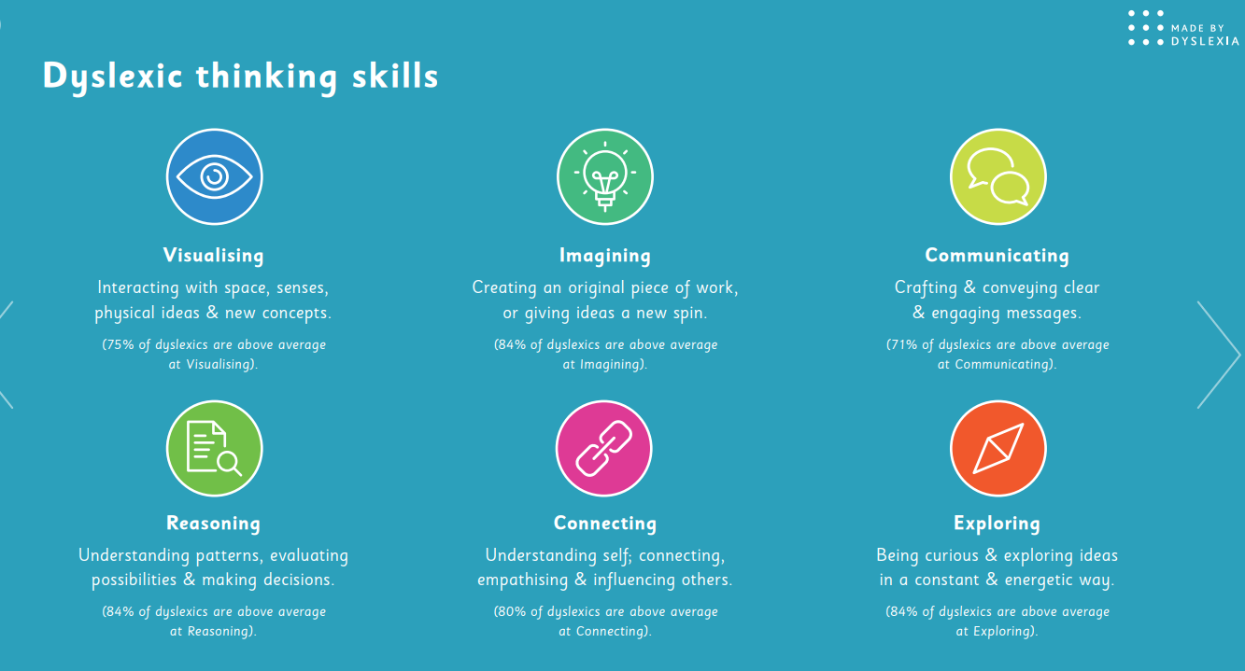
Dyslexic Thinking Strength

Slide 11
Dyslexia Screening Process
DIBELS
Dyslexia Screener is in addition to the reading assessment in K-2
Kinder - end of the year
1st grade - mid-year
2nd graders * - beginning of the year
7th Grade
TMSFA reading assessment is provided in the beginning of the year
*who have not previously been screened*

Slide 12
Dysgraphia - What is it?
A review of recent evidence indicates that dysgraphia is best defined as a neurodevelopmental disorder
manifested by illegible and/or inefficient handwriting due to difficulty with letter formation.
This difficulty is the result of deficits in graphomotor function (hand movements used for writing) and/or storing and retrieving orthographic codes (letter forms) (Berninger, 2015).
Secondary consequences may include problems with spelling and written expression.
The difficulty is not solely due to lack of instruction and is not associated with other developmental or neurological conditions that involve motor impairment.

Slide 13
Dysgraphia Characteristics
• Variably shaped and poorly formed letters
• Excessive erasures and cross-outs
• Poor spacing between letters and words
• Letter and number reversals beyond early stages of writing
• Awkward, inconsistent pencil grip
• Heavy/inconsistent pressure and hand fatigue
• Slow writing and copying with legible or illegible handwriting
• Multiple spelling errors
• Mixture of capital & lower‐case letters within words
• Lack of letter anchoring on lines- (swimming/floating letters)
• Simple word choice that does not reflect vocabulary abilities
• Lack of punctuation, capitalization, and paragraph indentation
• Written output does not match oral language skills
• Frustration/writing avoidance

Slide 14
Formal Evaluation for Dyslexia/ Dysgraphia
After a request for testing, the evaluation team will contact you to review the process.
The school has 45 school days to complete the evaluation.
Evaluation consists of formal and informal measures as determined by the evaluator.
Process of evaluation includes consideration of all possible Learning Disability categories.

Slide 15
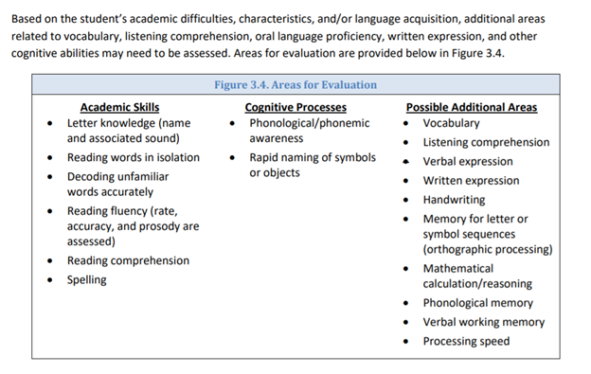
Identification Process: Dyslexia

Slide 16
Identification Process: Dysgraphia

Slide 17
Dyslexia Evaluation Practices
Dyslexia identification is based on the preponderance of evidence.
If the ARD committee determines that the student exhibits weaknesses in reading and spelling, the committee will then examine the student’s data to determine whether these difficulties are unexpected in relation to the student’s other abilities, sociocultural factors, language difference, irregular attendance, or lack of appropriate and effective instruction.
It is not one single indicator but a preponderance of data (both informal and formal) that provides the committee with evidence for whether these difficulties are unexpected.

Slide 18
Dyslexia Evaluation Practices
HB 3928 FAQ document provides three guiding questions:
Does the data show:
Difficulty with poor/accurate word reading
Poor Spelling
Poor Decoding
Do these result from a deficit in the phonological component on language
(average phonological scores alone do not rule out dyslexia)
Are these unexpected
for the student's age in relation to the students' other abilities and provision on effective classroom instruction

Slide 19
Changes to the Law regarding 504 students – HB 3928 Updates
If current 504 student receiving Dyslexia Direct Intervention services, the student MUST be evaluated for consideration of Special Education eligibility. Guidance is requiring that All students who are served by Section 504 for Dyslexia who continue to need an Evidenced Based Dyslexia Program (direct Dyslexia intervention) will be assessed by the end of the 2024-25 school year.
Direct Dyslexia intervention will no longer be available through Section 504. This Intervention is now categorized as a Special Education Service by HB. Due to this, students who require direct Dyslexia Intervention MUST be evaluated and eligible for Special Education. Once eligible, direct Dyslexia Intervention services will be available for the student. If a parent does not give consent for a Special Education Evaluation, the student will not be able to access the Special Education service of direct Dyslexia Intervention. This is a change and will only impact students who currently receive Direct Dyslexia Intervention through Section 504. This will not impact new referrals for evaluation.
.

Slide 20
Changes to the Law regarding 504 students – HB 3928 Updates
What if a parent does not give consent for either an FIIE when dyslexia is suspected or for the provision of special education and related services when dyslexia is identified?
From TEA: "Beginning with the 2023-2024 school year, which is the school year in which HB 3928 first applies, a student will not be entitled to receive an evidence-based dyslexia program if a parent refuses to consent to the provision of special education and related services following an FIIE or after an ARD committee has determined that the student is eligible for special education based on the identification of dyslexia and a need for an evidence-based dyslexia program."
To rephrase: Starting this school year, a student will no longer be able to receive Direct Dyslexia Intervention services UNLESS they are eligible and receiving Special Education services with parent consent.

Slide 21
Changes to the Law regarding 504 students – HB 3928 Updates
If a student no longer needs an evidence-based dyslexia program (Direct Dyslexia Intervention), might that student eventually be exited from special education and placed on a Section 504 plan?
If the student is considered to be ON GRADE level, BUT still requires Direct Dyslexia Intervention, this student will continue to qualify for Special Education Services based on the need for Direct Dyslexia Intervention.
When an ARD committee determines a student with dyslexia no longer requires a Direct Dyslexia Intervention, it might determine that the student still would benefit from regular education aids and services (e.g., instructional accommodations). In that case, if a Direct Dyslexia Intervention was the only special education and related services the student received, the ARD committee could determine that the student no longer meets criteria and exit the student from special education, and transition the student to a Section 504 plan as necessary.

Slide 22
Teaching Strategies, Interventions, and Accommodations/Modifications

Slide 23
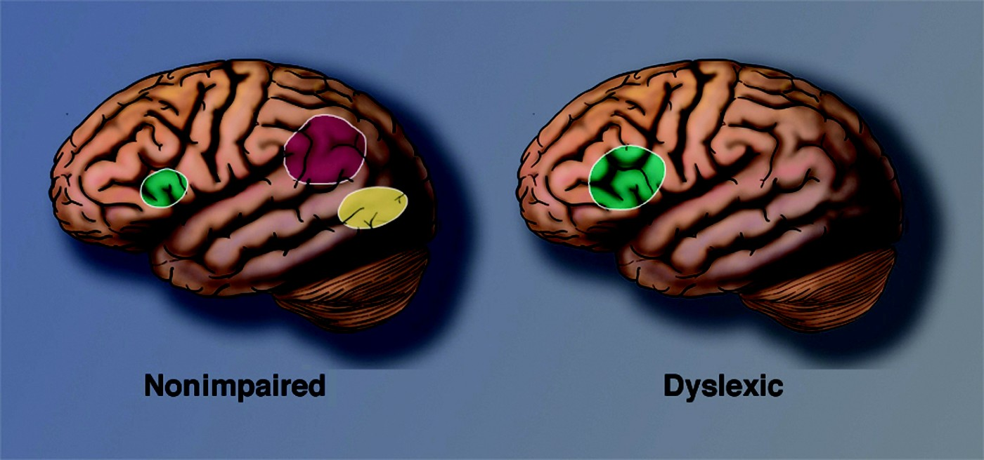
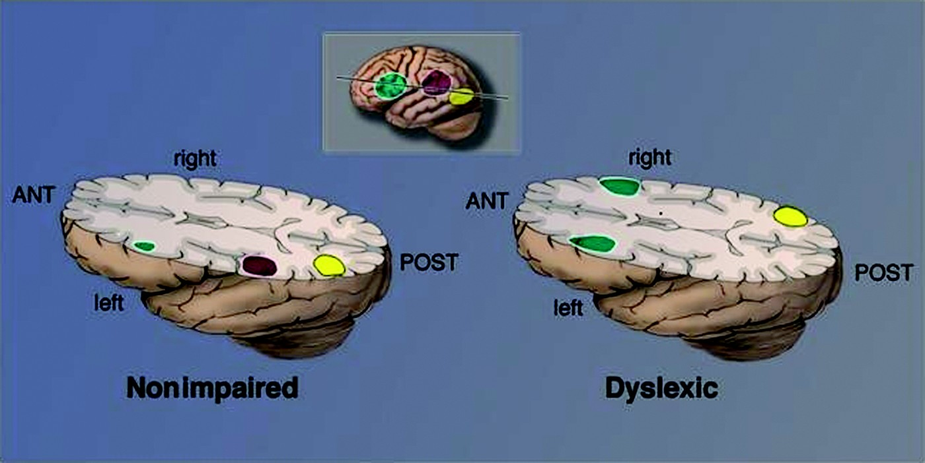
Dyslexia Instruction
Repetitions of Foundational Reading Skills
1-4 gifted student
4-14 typical student
14-40 struggling reader
40-200 student with a Dyslexia or LD
Originally from p 66 of A Principal's Primer for Reading Achievement by Pati MontgomeryDallas Branch of International Dyslexia Association
S. Shaywitz and J. Shaywitz (2020, pp. 68–86)

Slide 24
Dyslexia Instruction
Effective
Systematic, Explicit, Multi-Sensory Instruction
Ineffective
Color Overlays
Balance Therapy
Special lighting
Vision Therapy
"Quick Fix" programs
Addresses
Evidenced-based
Phonology
Sound-symbol association
Fluency
Syllabication
Orthography
Morphology
Syntax
Comprehension
*For additional information see pg 39-41, 53 of the Texas Dyslexia Handbook

Slide 25
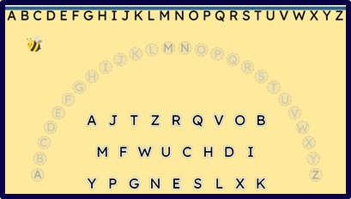
MTA Intervention

Slide 26
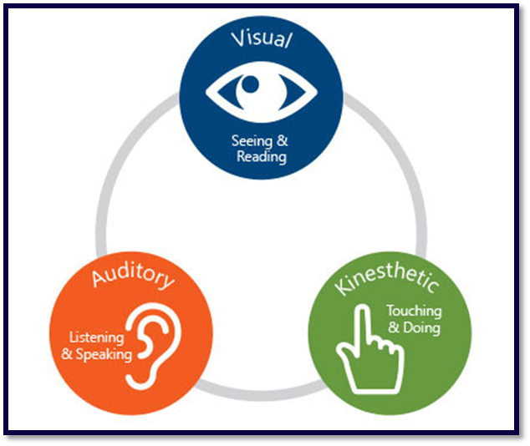
MTA Intervention

Slide 27
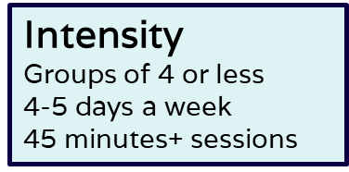
MTA Intervention
180-240 minutes per week
3-5 year program- progress based on individual needs
Amplio Platform- curriculum integrated into an online platform, virtual option
Trained instructor

Slide 28
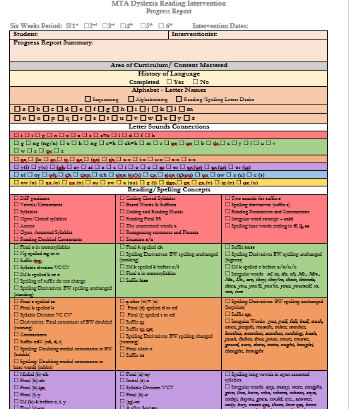
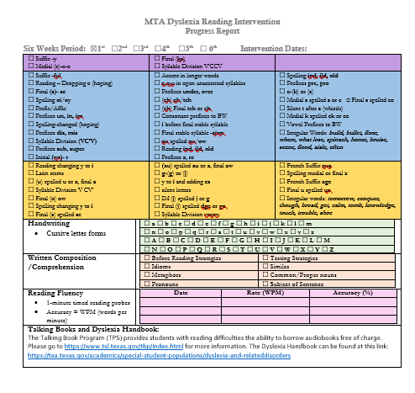
MTA Progress Report
6 Weeks
Curriculum Progress
Kits 1-7, Reading Probes, Additional areas
In addition to IEP goal

Slide 29
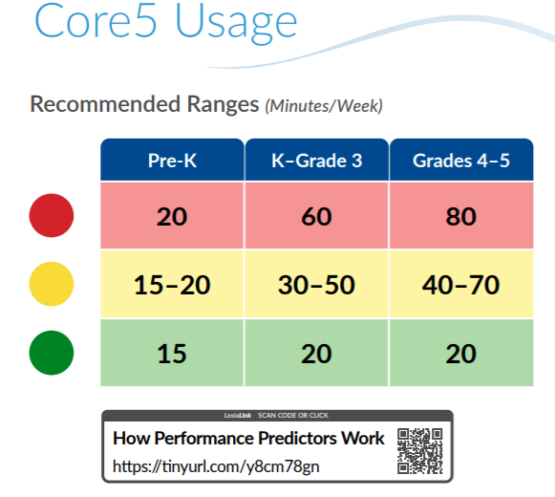
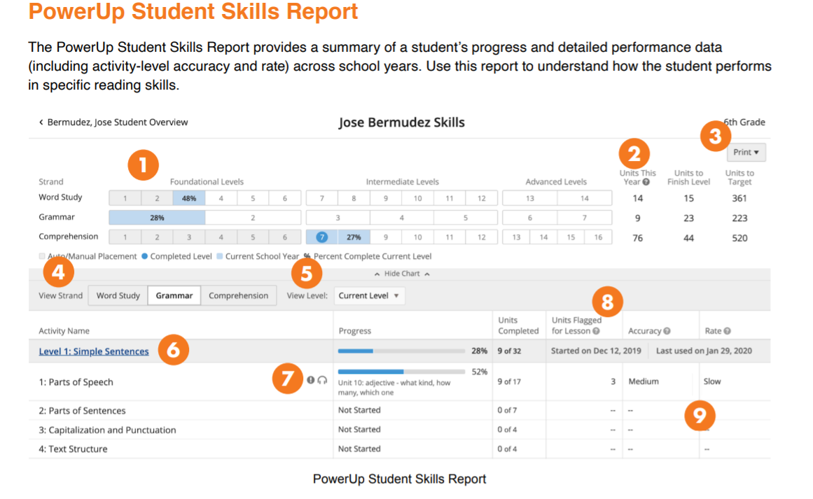
Lexia Program
Lexia Core5 - K-5th
Lexia PowerUp - 6th-12th
Diagnostics and Placement
Recommended times
6 Weeks Progress Reports

Slide 30
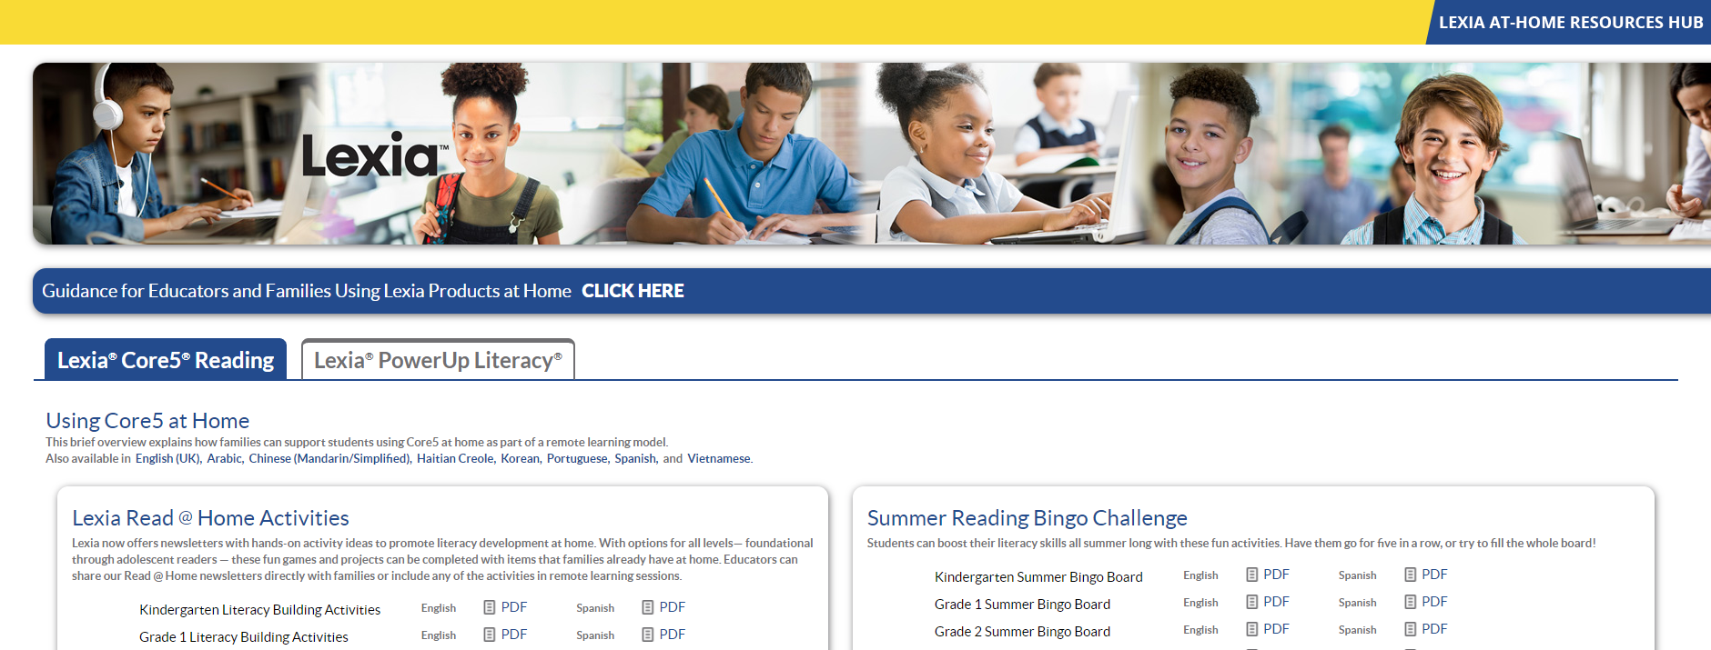
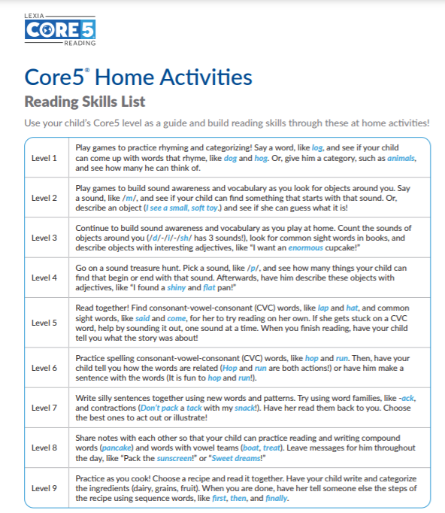
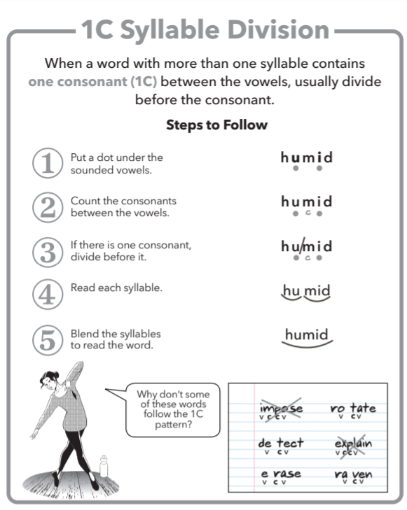
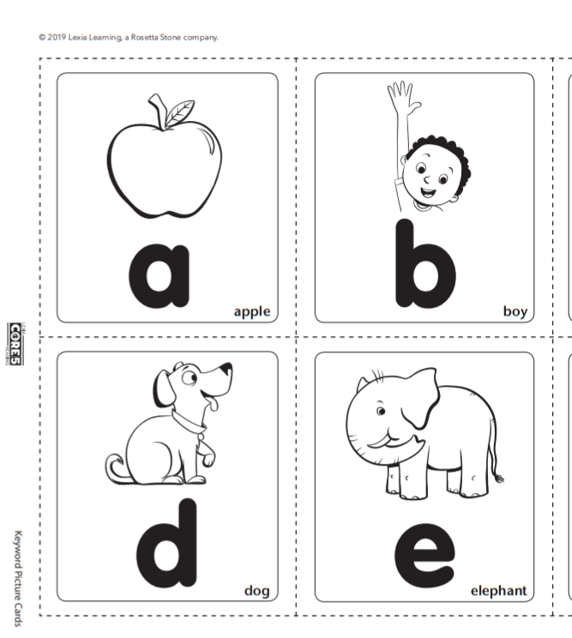
Lexia Parent Resource Hub
www.lexialearningresources.com/lexia-at-home.html
Core 5
Home Activities List
Lesson Overviews
Flash Cards/Letter Tiles
Skill Builders
PowerUp
Newsletter Activities
Lesson Overviews
Anchor Charts
Skill Builders

Slide 31
Accommodations & Modifications
Accommodations
HOW-
Changes to materials, procedures, techniques
Lower level reading text to access science curriculum
Modifications
WHAT-
Changes to the level on instruction provided or tested
Lower level reading text to access reading fluency/comprehension

Slide 32
Common Accommodations
Reading/Writing
Oral Administration of tests & assignments
Oral response to short answer when possible
Text-to-Speech
Speech-to-text
Word Predication
Cloze notes/guided notes/copy of class notes
Working Memory/Organization
Graphic Organizers
Writing Checklists
Time-lines
Visuals
Calculator
Formula Charts
Graph paper to line up math problems
General
Alternate assessment when possible- multimedia presentation, use of art/poster projects, hands-on demonstration of knowledge
Preferential seating
Extra Time

Slide 33
Tech Tools
Immersive Reader
One-Note Speech/Text
Google Docs Speech/Text
Accessibility Features
Learning Ally Audio Books

Slide 34
Implications for Math/Science/Social Studies
Difficulties Sequencing Formulas Numbers/Calculations Rote Memorization Rapid recall of facts Directionality
Strengths
Visual/Spatial Thinking
Big Picture
Reasoning/Pattern Recognition
Geometry/3D Shapes

Slide 35
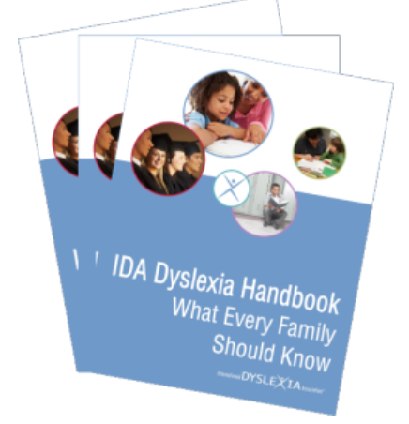
Resources for Parents
Books
Overcoming Dyslexia
by Sally Shaywitz, M.D. and Johnathan Shaywitz, M.D.
Websites
Madebydyslexia.org
Dyslexiaida.org - International Dyslexia Association
Understood.org
Dyslexia.yale.edu - The Yale Center for Dyslexia & Creativity

Slide 36
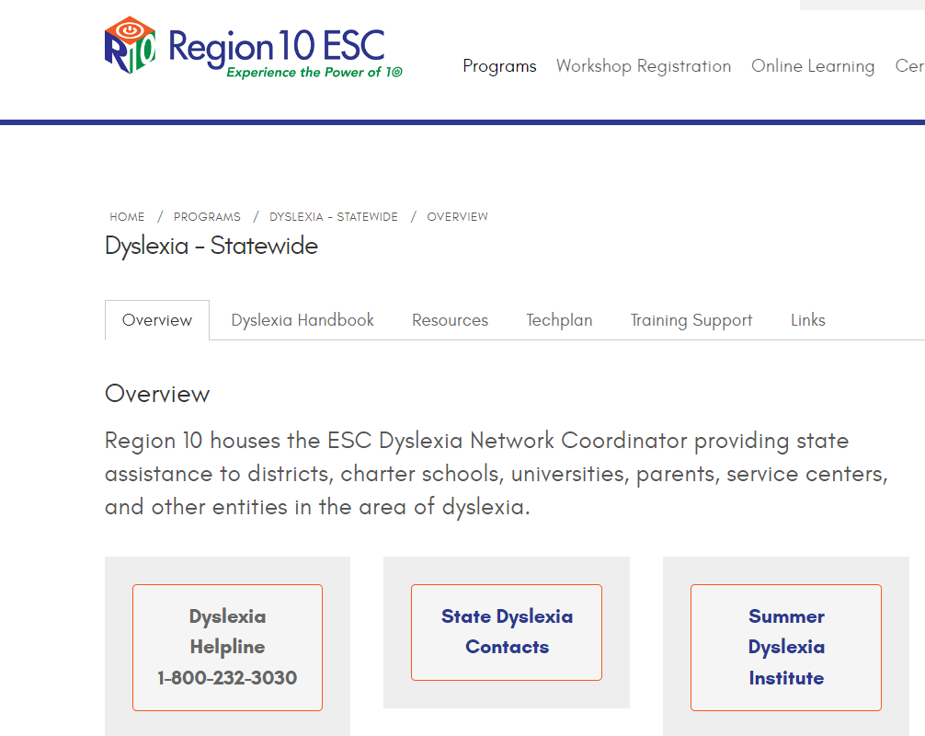
Resources for Parents
TEA Resources
Dyslexia & Related Disorders Website
The Dyslexia Handbook
HB 3928 FAQ Documents
Additional information
Documents in both English & Spanish
Region 10 Statewide Dyslexia Page
https://www.region10.org/programs/dyslexia-statewide/overview/
https://tea.texas.gov/academics/special-student-populations/dyslexia-and-related-disorders

Slide 37
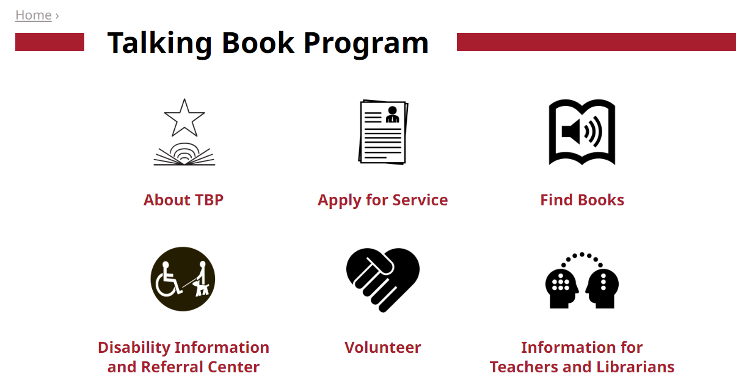
Resources for Parents
Audiobook Resources
Talking Book Program
https://www.tsl.texas.gov/tbp/index.html
Learning Ally
Learningally.org

Slide 38
Parent Handouts
Signs of Dyslexia by Age
Common Misconceptions
Resource List
Stages of Writing Development

Slide 39
Parent Handouts
https://utelementary.org/dyslexia-services/
https://utcharter.org/dyslexia-services/

Slide 40
Question & Answer

Slide 41
Contact Information
UTCSS Dyslexia Program
Karena Hayes, M.Ed. – Lead Dyslexia Interventionist
Karena.hayes@austin.utexas.edu, 859-319-8727
UTES/UTCSS Special Education Department
Janina Roberts, MA, LSSP – Director of Special Programs
Jroberts@austin.utexas.edu
Julie Joesel, MA, LSSP – Lead School Psychologist
jjoesel@austin.utexas.edu, 512-923-3322

Slide 42
Citations
Cowen, C. D. (2016). What is structured literacy? - International Dyslexia Association. What is Structured Literacy. Retrieved October 6, 2021, from https://dyslexiaida.org/what-is-structured-literacy/.
Texas Education Association. (2018). The Dyslexia Handbook, 2018. Retrieved from https://tea.texas.gov/sites/default/files/2018-Dyslexia-Handbook_Approved_Accomodated_12_11_2018.pdf.

Slide 43
Thanks!
youremail@freepik.com | +00 240 576 092 | yourcompany.com
Please keep this slide for attribution.

